Slide 1
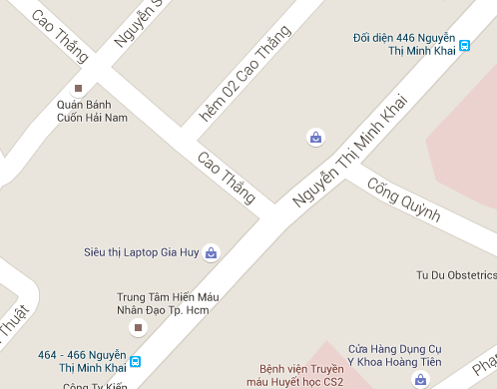
Scenario
Nickname of Mr. Khuong is “Khuong không sợ chết”.
Mr. Khuong always drives with high speed.

Slide 2
Scenario
Nickname of Mr. Khuong is “Khuong không sợ chết”.
Mr. Khuong always drives with high speed.

Slide 3
Scenario
Nickname of Mr. Khuong is “Khuong không sợ chết”.
Mr. Khuong always drives with high speed.
He is notified when he near next turn.
Notify: prepare to turn left

Slide 4
Scenario
Nickname of Mr. Khuong is “Khuong không sợ chết”.
Mr. Khuong always drives with high speed.
He is notified when he near next turn.
But he passes it and keeps go straight.
He doesn't know that he has lost then he still drives.

Slide 5
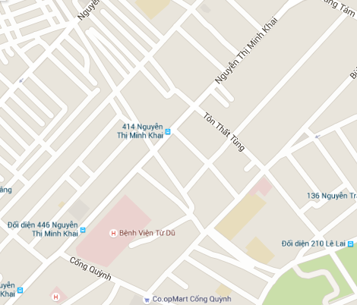

Scenario
He has far away from right route when he checks map again.

Slide 6
Problem
Don’t has any application that allow users know if they are going to the wrong route.

Slide 7
Solution
Provide detect wrong route function.
Help users know if they are going to wrong route.
User can research to get right route.

Slide 8
Detect wrong way algorithm

Slide 9
E
A
C
D
B

Slide 10
Notify: wrong way
E
A
C
D
B

Slide 11
E
A
C
D
B

Slide 12
E
50
A
C
D
B

Slide 13
E
50
A
C
45
D
B

Slide 14
E
50
20
A
C
45
D
B

Slide 15
E
50
20
A
C
15
45
D
B

Slide 16
E
50
13
A
C
20
15
45
D
B

Slide 17
E
A
C
D

Slide 18
E
A
C
D

Slide 19
Notify:
E
A
C
D

